Slide 1
Do..While LOOP
Lecturer: Nadia Binte Asif

Slide 2
SYNTAX
do{
//code to be executed
}while(condition);
Post tested loop
Cases where we need to execute the loop at least once
Used in menu-driven programs→ termination→ users
Initialization inside loop
non-zero value as the conditional expression.

Slide 3
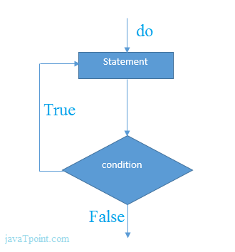
SYNTAX
do{
//code to be executed
}while(condition);

Slide 4
Example
#include<stdio.h>
int main(){
int i=1;
do{
printf("%d \n",i);
i++;
}while(i<=10);
return 0;
}
FOR LOOP?

Slide 5
PROBLEMS
Write a Program to print table for the given number using do while loop.

Slide 6
Break and continue statements

Slide 7
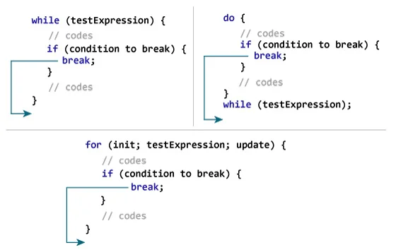
break
Ends the loop immediately when it is encountered

Slide 8
Example
int i;
for(i = 0; i<10; i++)
{
printf("%d ",i);
if(i == 5)
break;
}
printf("came outside of loop i = %d",i);
}
#include<stdio.h>
int main(){
int i=1,j=1
for(i=1;i<=3;i++){
for(j=1;j<=3;j++){
printf("%d %d\n",i,j);
if(i==2 && j==2){
break;
}
}
}
return 0;
}

Slide 9
Program to calculate the sum of numbers (10 numbers max) [ If the user enters a negative number, the loop terminates ]
#include <stdio.h>
int main() {
int i;
double number, sum = 0.0;
for (i = 1; i <= 10; ++i) {
printf("Enter n%d: ", i);
scanf("%lf", &number);
// if the user enters a negative number, break the loop
if (number < 0.0) {
break;
}
sum += number; // sum = sum + number;
}
printf("Sum = %.2lf", sum);
return 0;
}

Slide 10
int n=2,i,choice;
do
{
i=1;
while(i<=10)
{
printf("%d X %d = %d\n",n,i,n*i);
i++;
}
printf("do you want to continue with the table of %d , enter any non-zero value to continue.",n+1);
scanf("%d",&choice);
if(choice == 0)
{
break;
}
n++;
}while(1);

Slide 11
OUTPUT
2 X 1 = 2
2 X 2 = 4
2 X 3 = 6
2 X 4 = 8
2 X 5 = 10
2 X 6 = 12
2 X 7 = 14
2 X 8 = 16
2 X 9 = 18
2 X 10 = 20
do you want to continue with the table of 3 , enter any non-zero value to continue.1
3 X 1 = 3
3 X 2 = 6
3 X 3 = 9
3 X 4 = 12
3 X 5 = 15
3 X 6 = 18
3 X 7 = 21
3 X 8 = 24
3 X 9 = 27
3 X 10 = 30
do you want to continue with the table of 4 , enter any non-zero value to continue.0

Slide 12
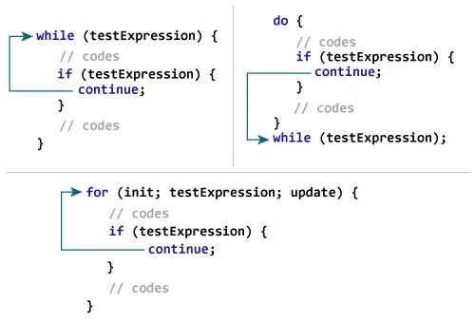
continue
Skips the current iteration of the loop and continues with the next iteration

Slide 13
Program to calculate the sum of numbers (10 numbers max) [ If the user enters a negative number, it's not added to the result ]
#include <stdio.h>
int main() {
int i;
double number, sum = 0.0;
for (i = 1; i <= 10; ++i) {
printf("Enter n%d: ", i);
scanf("%lf", &number);
// if the user enters a negative number, break the loop
if (number < 0.0) {
continue;
}
sum += number; // sum = sum + number;
}
printf("Sum = %.2lf", sum);
return 0;
}

Slide 14
#include<stdio.h>
void main ()
{
int i = 0;
while(i!=10)
{
printf("%d", i);
continue;
i++;
}
}
int i=1;
for(i=1;i<=10;i++){
if(i==5){
continue;
}
printf("%d ",i);
}
OUTPUT
1 2 3 4 6 7 8 9 10
OUTPUT
infinite loop

Slide 15
#include<stdio.h>
int main(){
int i=1,j=1
for(i=1;i<=3;i++){
for(j=1;j<=3;j++){
printf("%d %d\n",i,j);
if(i==2 && j==2){
continue;
}
}
}
return 0;
}
OUTPUT
1 1
1 2
1 3
2 1
2 3
3 1
3 2
3 3

